Slide 1
Capstone Project: Trends, Cost Analysis, and Epidemiology of Soft Tissue Transfer using NIS
By Kathy Ochoa

Slide 2
Source
Healthcare Cost and Utilization Project (HCUP)
The nations most comprehensive source of hospital care data.
Within the HCUP databases is the National Inpatient Sample (NIS)
Largest publicly available hospital inpatient care database in the U.S.
Contains data on more than seven million hospital stays.
The files are divided by by year
Each year is divided into 4 files:
Core, hospital, severity, and diagnosis and procedure file.
Core files are a single file containing commonly used data elements (age, primary payer, total charges, etc.).
We will be using the NIS Core datasets from 2016 - 2019

Slide 3
Quality
Data is randomly sampled, unbiased, and representative of the nation.
Data can be used to identify, track and analyze national trends in health care.
Data contains many years (32) with plenty of columns and observations.
We will explore 40 columns of diagnosis and 25 columns of procedures.
We will also explore 9 categorical variables.
Data should not be used to make state-level estimates.

Slide 4
Data Ingestion/ Wrangling
Read in the 4 csv files, defining all the possible NA’s in the datasets
Create lists of common columns between datasets
Merge (Full join) all 4 datasets by the common column lists
Create a new dataframe selecting all the categorical variables, then filter observations that lie within their respective ranges
Rename categorical variables
Create a list of diagnosis codes of interest
Run a for loop iterating through the DX columns of the dataframe, selecting the rows that correspond to the associated diagnoses
Create a list of lower flaps procedures and upper flaps procedures
Run a for loop iterating through the PR columns of the dataframe, selecting the rows that correspond to the codes from the lists of flaps

Slide 5
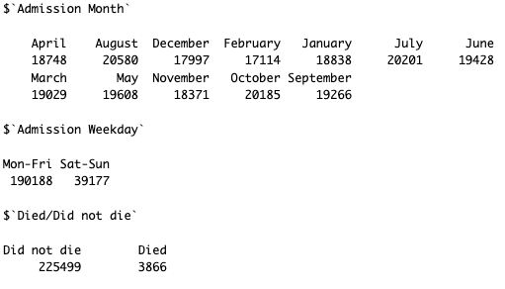
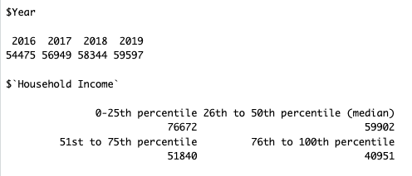
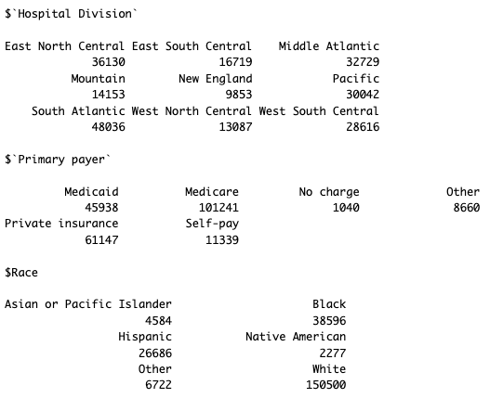
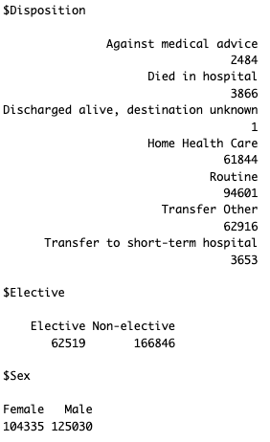
Important Results – Tabular demographics

Slide 6
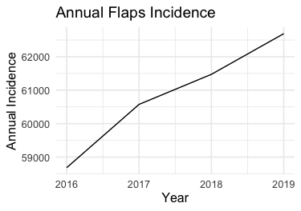
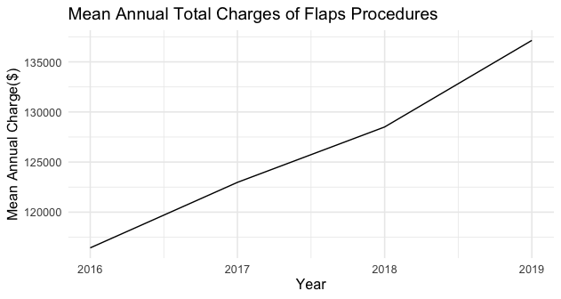
Important Results - Visualizations

Slide 7
More to come:
Bar graphs of the top 10 associated diagnosis
Bar graph of the top 5 most common upper flaps procedure codes
Bar graph of the top 5 most common lower flaps procedure codes
Generalized linear models
Analysis on lower vs upper extremity flaps procedures to determine differences across total charges age, and race

